Slide 1
Python Getting Started

Slide 2
Introduction
The general introduction to Python scripting, this will be general Python and have no direct connection to geoprocessing our focus.
Some of the operations discussed in this part will be covered again in other parts when they deal specifically with geospatial applications.

Slide 3
Purpose
Many times we run the same operation on multiple data sets which causes the user to do:
Repetitive operation
Manually make decisions based upon the data
Create maps that can be less functional because we use a one size fits all approach
In using a Python script you will:
Learn how to automate multiple functions into a single script
Create solutions based upon the data
Use decision making routines on how a field is displayed and/or calculated
Create specialized tools for your own operational needs
This course will introduce Python Scripting and the use of geoprocessing tools within Python Code, but is not meant to make the user an expert Python programmer. No single course can do that, but it will provide the user the expertise to use Python Scripts to make redundant processes simpler and quicker.

Slide 4
Specifics
This module will assist you in the understanding of the Python language and parameters.
The major component of this module:
Learning operational components of Python
Understanding some of the formatting of scripts

Slide 5
Important Concept
Command names are case sensitive and must be used appropriately.
Variable names are also case sensitive. The variable name countyName and countyname are not the same variable.
Formatting of the script is critical to the correct operation, this includes the indention of lines.
These script lines will be done in the immediate mode and not as a program. Immediate mode means that when an enter (return) is pressed on the keyboard, the line executes the command, the exception would be for some specific functions such as a loop.

Slide 6
Comment
Comments
are anything written after a pound sign (#), it will have no effect on the operation of the program.
should be used to define the author and information about the author.
should also be used to name the program or parts of the program.
should be descriptive of what the program is doing at specific locations within the script.
can also be used when parts of a program will not run by using the # in front of a line of code to thus eliminating that line from the operation of the program.
can be on their own line, or within a line of operational code.

Slide 7
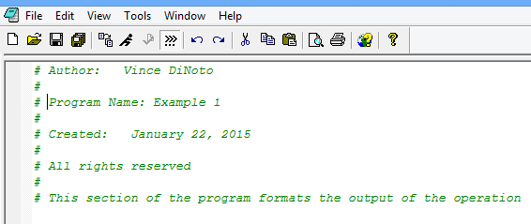
Comment Example
The first line of code is used to give the name of the author. Additional information about the author should be given as well.
Note the next line is blank and used only a pound sign.
The name of the program is a critical component, the date the script was created (written) and/or modified is important.
What are the rights of someone wanting to use a particular script is critical. It’s suggested that you allow others to use your scripts since this is part of an open learning community, make sure that you know your employer policies on making scripts available outside of the organization.
The last line might be placed in the body of the program to explain what is being done in that specific location in your script. Programs may have hundreds of lines of text and it is important to explain what is occurring. By using comment statements it will be easier to edit and modify your script. Many times we write a script, use it, and then may not use it again for several weeks or months; the comments will make it easier for you to use your own work.

Slide 8
Variables
A variable is a place holder for information; there are two main types of variables
A string (text), the information must be placed between either a single or double quotation mark.
A number
Variables can be added together but they must be of the same type
If the variables are not of the same type you can use the str (string) function to add a number to a string.
To add a string to a number use str(number variable)
A variable can be a list of common item (array), square brackets[] are used when it is a list.
It is suggested to use both upper and lower case letters in the name and make the name very descriptive, this will make it easier to edit.
Remember Python is case sensitive.

Slide 9
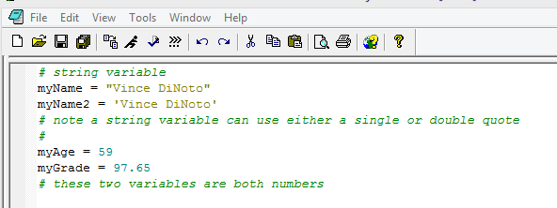
Variable Example
Note the comment statement has been used to explain the different variable types.
A single or double quote can be used to define a string, therefore the variable myName and myName2 do the same operation.
Note the PythonWin IDE shows numbers and strings in different colors to make it easier to understand and edit (troubleshoot), as well as the comments. The colors are not part of the script and varies with different IDEs.

Slide 10
Assignment
Your Inputs:
Create two variables for your name; one variable for your first name and one for your last name.
Create a variable for your age.
Put comments in the script to define who wrote the script, when it was written and the purpose of the script.
Your Outputs:
Provide you instructor with a screen image of your script.
Learning Objectives:
Variables
Comments

Slide 11
List Variable
A List contains more than one element of the same type in a single variable name and can be individually addressed. This is also referred to as an array.
A List can contain strings or numbers.
To make sure you know which variables are list, name them appropriatly like addressList or listAddress.
Remember all variable names are case sensitive.

Slide 12
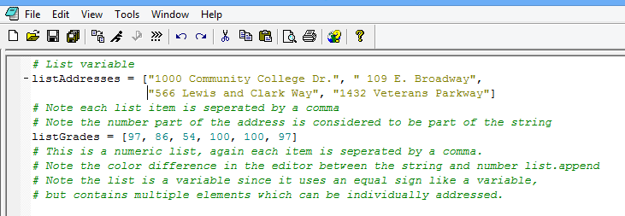
List Example
Note if you have an error in your coding (it will be in red), you cannot edit that line of code directly since you are working in immediate mode. Go to the line with the error press return, the code will be entered on the next new line, and then you can edit it. The reason is that you are in immediate mode and the line of code with the error has already been executed.

Slide 13
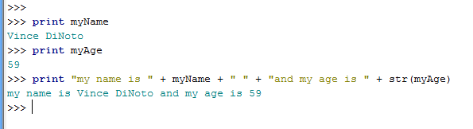
Print
The first print statement uses the variable previously defined as, myName
The second print statement uses the variable previously defined as, myAge
The third print statement combines the two variable together with text
Note the text is in double quotes
We put the number variable into a function called string (str) since you cannot add strings and numeric values together.
Spaces have been put into double quotes to make the output look proper.
The plus sign adds the features together.

Slide 14
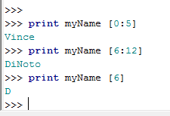
Printing only part of a variable
We are using the variable, myName previously defined in this module. If this variable is not loaded you will need to reload the variable (reenter the variable in the command line).
In the first statement we are printing from position 0 (the first location in the variable) in the variable myName up to the 5th position, but not including the 5th position. Thus the V is in the 0 position, the i in the 1 position and so on. It prints 5 characters.
In the second example we are at print position 6 (remember your count starts at 0), up to but not including the 12th position.
In the final example we are printing only the character in the 6th position.

Slide 15
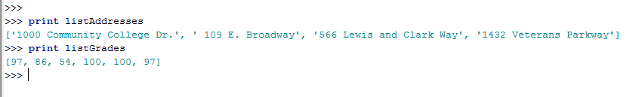


Print with a list
You can print all the members of a list by simply using the print command and list variable name. The listAddresses and listGrades variables were loaded prior to this example. If you want to print the third element in a list use the method shown below. If this variable is not loaded, you must load it prior to doing the examples.
Note, that square brackets are used, and the number 2 is used since the first element of the list is number 0.
Note, that the first number in the square bracket is the element in the 1st position, the second number is to print up to this position, thus printing the 2nd position also.

Slide 16
Assignment
Your Inputs:
Define variables that are both text and numeric.
Define a List variable.
Your Outputs:
Print the variables including the List variable
Print your first and last name and age which are three different variables, along with text that has been directly added to the code.
Print the second member of a List variables.
Make sure you comment in your script on the operation.
Send the faculty member a screen image of the IDE showing the code.
Learning Objectives:
Variables
List
Printing

Slide 17
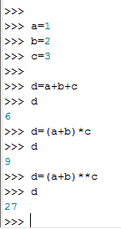
Basic math with a variable
In the first three lines, the variables, a, b and c are defined
The variable d is defined to be the sum of the three variables and the answer is shown to be 6; you could have also used a print statement.
In the next expression the variable d is defined to be the sum of a and b multiplied by the variable c. It uses basic algebra functions and does what is in the brackets first before doing the multiplication. The answer 9. Mathematical order of operations must be followed. The variables a, b and c were defined above and retain their initial values, until they are redefined or cleared.
The double asterisks means that is raised to the power of c; (a+b)^{c} . Thus a+b equals 3 and 3 to the third power is 3x3x3 = 27
For more complex mathematics you may need to load the math module. We will cover loading of modules in the next module.

Slide 18
Decision making statements
Decision making statements are a main component of most all computer programming language, the formatting is different between different languages:
A true or false statement from logic will determine the next step in the operational code that will be done.
For a statement which is true, the script will branch in one direction and when the statement is false the branch will be in a different direction.
Typically these decision making statements are represented in a flow chart with a diamond shaped symbol.
Both code methods and diagramming will be shown on the next slide. In Python these statements are known as if/elif/else.
The concept is, if true do a, else if true do b, else do c.
Note when the colon is used so that the next code line is indented and does not immediately execute the command, it takes a pressing of the Enter key twice to execute the command.

Slide 19
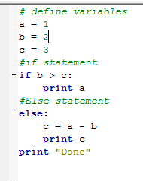
if / else
In the script, 3 variables are defined, this might be from a user input.
The if statement is put into the code and must have a colon at the end. This will create a proper indention in the next line.
If b is greater than c, when it is true what is indented under the if statement would occur, it would print the value of a, if false it will drop to the else statement. Note an else if statement is not used in this example.
This will make c the difference between a and b which is -1 and then it will print -1.
If true or false it will then drop to the final print statement and print Done. The else statement is not required but makes the workflow cleaner.
Since the variables are hard coded there is only one solution. You can vary the values of a, b and c.
Note: The dash next to if and else statements is added by the software.
a=1
b=2
c=3
True
If b>c
print a
False
else
c=a-b
print c
print “Done”

Slide 20
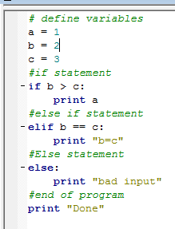
if /elif / else
a=1
b=2
c=3
if b>c
True
print a
False
The flow is if b is great than c print a
if not see if b=c if true print b=c
if not print bad input.
No matter which path it takes then print done.
elif stands for; else if
Vary the values of a, b and c
elif b=c
True
print “b=c”
False
else
print “bad input”
Print “done”

Slide 21
Assignment
Your Inputs:
Create an if/elif/else process
Define four variables
If variables 1 & 2 added together is greater than variables 3 & 4 multiplied together, print “Successful”
Else if variable 2 is equal to variables 1, 3 & 4 added together, print “minor error”
Else, print “this program gave a null result”
Your Outputs:
An image of your script
A flowchart of your code
Learning Objectives
Mastery of the if statements

Slide 22
for / loops
Inputs
Another fundamental function most all computer languages utilize is a looping statement.
A for loop will go through a process a specified number of times and then will exit the loop.
Anything inside the loop will be done and then returned to the top of the loop which will increment the loop.
The loop will than go to the next item, when all items in the list have been completed the loop will exit.
Loops can be placed inside of other loops.
This nesting of loops is fairly common so if the bigger process is done 10 times and the inner process is done 5 times.
The inner process runs five times and then jumps to the outer loop process, which brings it back to the inner process.
The inner process will run a total of 50 times.
The use of the colon at the end of the for statement is critical to indent and make the operation run correctly.
A similar statement is the while statement.
for loop
Criteria met
Operation
Loop exit point

Slide 23
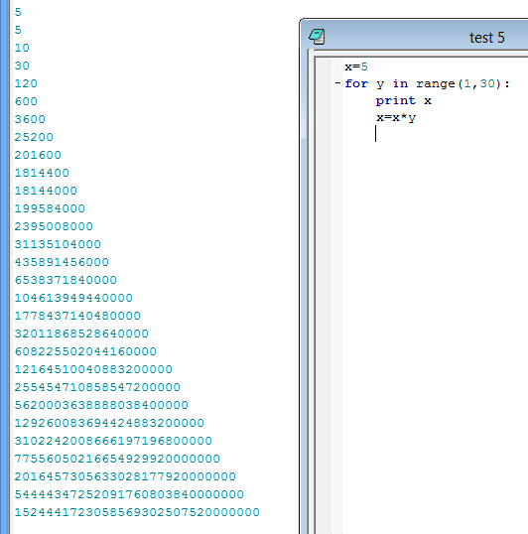
for
The variable x is initially set to be 5
The loop will run 29 times, because when we reach 30 it exits.
It will print the value of x and then make x equal to x times the loop counter y.
Initially x is printed being 5.
x=x*y is x=5*1, we return to for statement, y becomes 2, we print value of x which is 5, we multiple x=x*y which is x=5*2 or 10. We return to the for statement, y becomes 3, we print x which is 10 and do the multiplication which makes x=30 and the process continues.
Would you get different results if the print statement was after the algebra statement? Thought Question

Slide 24
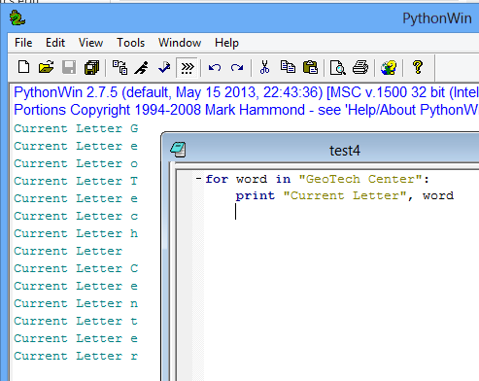
for statement
The front window shows the code and the back window, shows the result of running the code.
The for statement, use a variable ‘word’ so the loop is done the number of letters in GeoTech Center including the space, thus the operation runs 14 times.
The print statement prints what is in the quotes each time and the letter that corresponds to the number of times the loop has been done.
Each time through the loop, the value in the variable word is incremented one position.

Slide 25
Assignment
Your Inputs:
Write a for loop that will take your name which is defined in two variables that you added together to create a new variable.
Print each letter of your name as a separate line with the following code:
Letter 1 is and the letter
Note the number 1 and the V (for the authors name) should be part of a single line of code (each being a variable) and the word “Letter” and “is” are input inside of quotation marks.
Your Outputs:
Screen images of the script and the output
Learning Objectives:
For loops

